Slide 1
Storyline
Three/four types (qualitative)

Slide 2
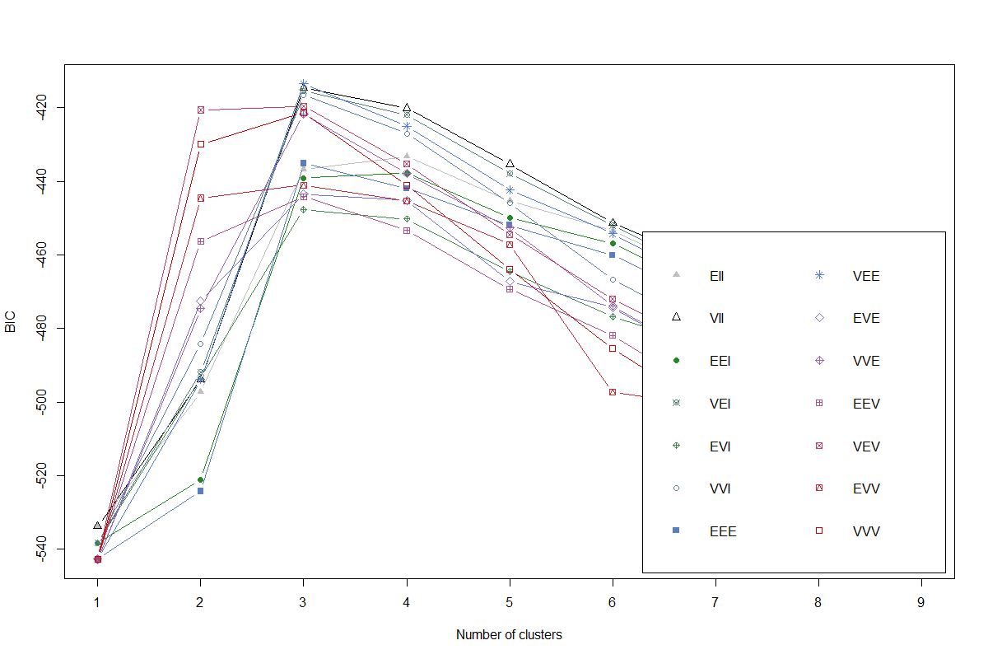
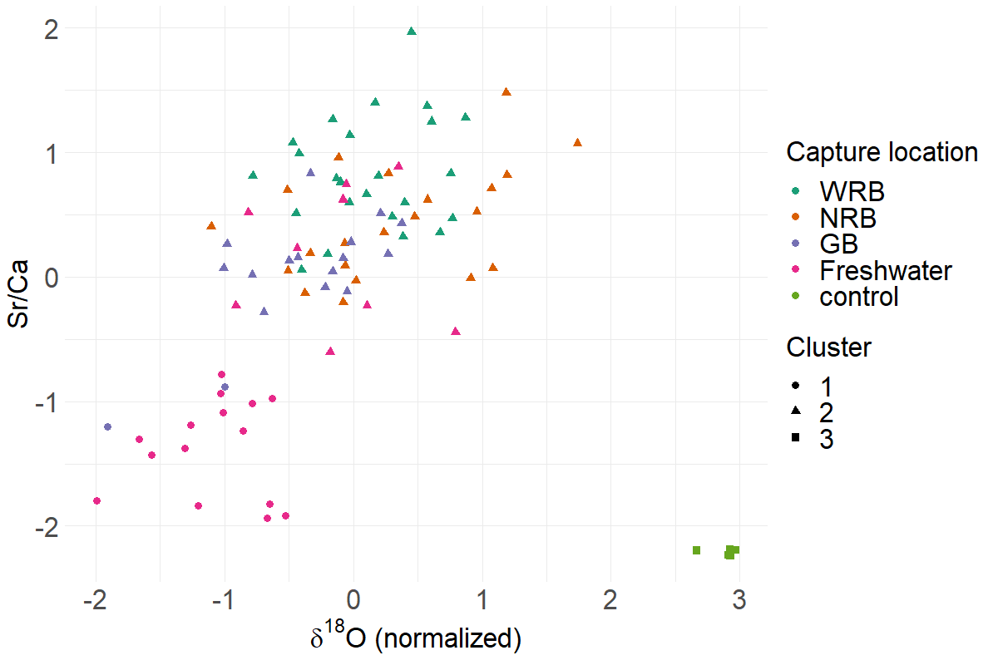

Slide 3
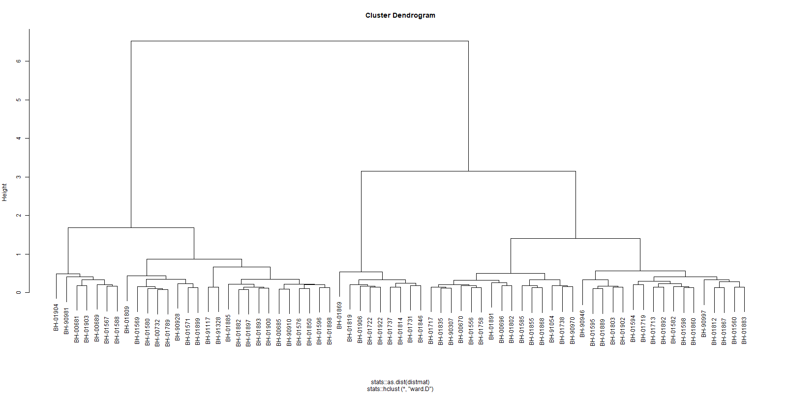
DTW dendrogram Sr (with cut)

Slide 4
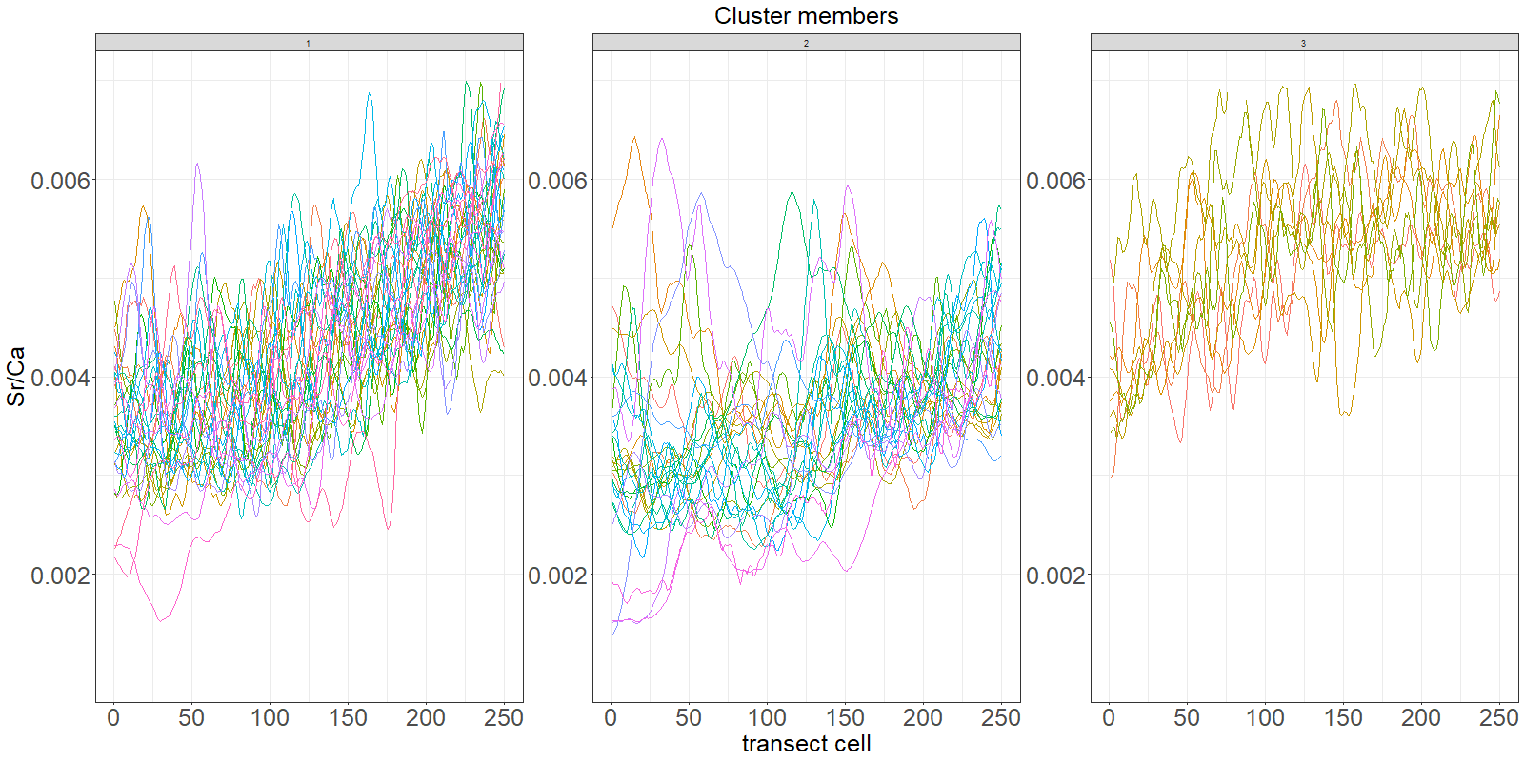
DTW series Sr

Slide 5
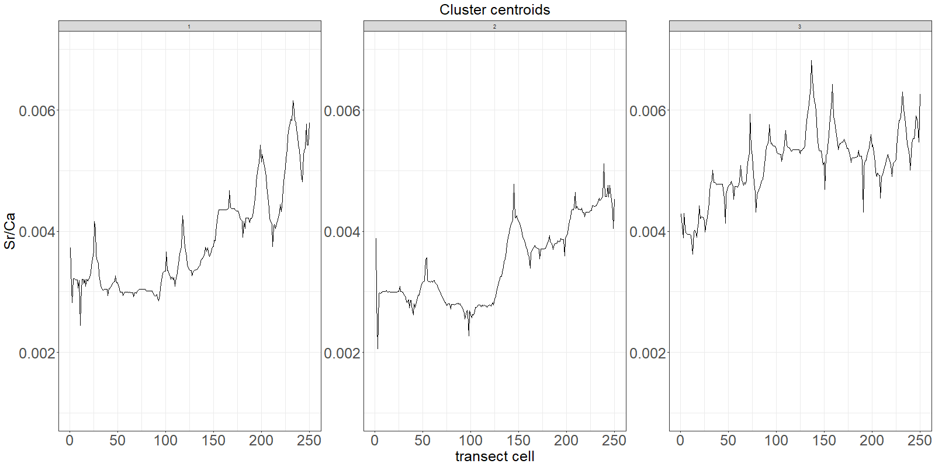
DTW centroids Sr

Slide 6
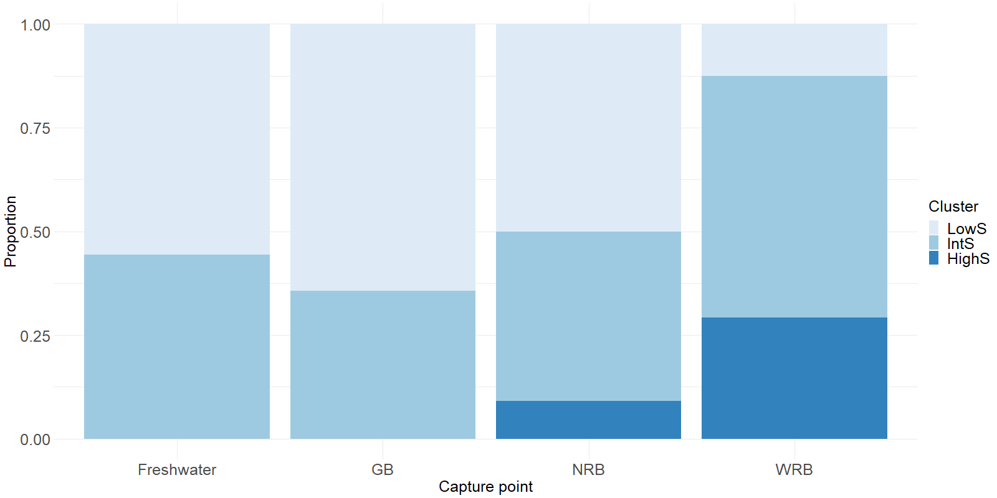
Cluster distribution

Slide 7
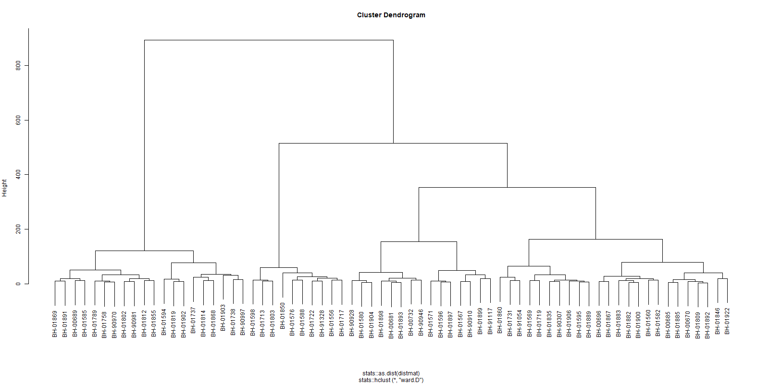
DTW dendrogram d18O (with cut)

Slide 8
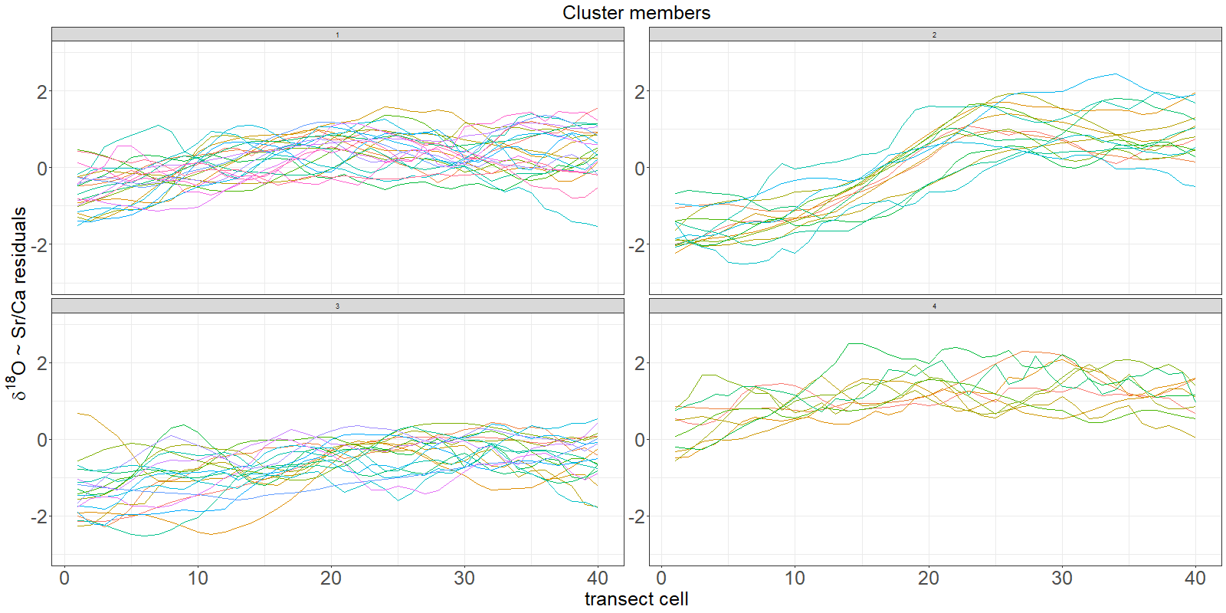
DTW series d18O

Slide 9
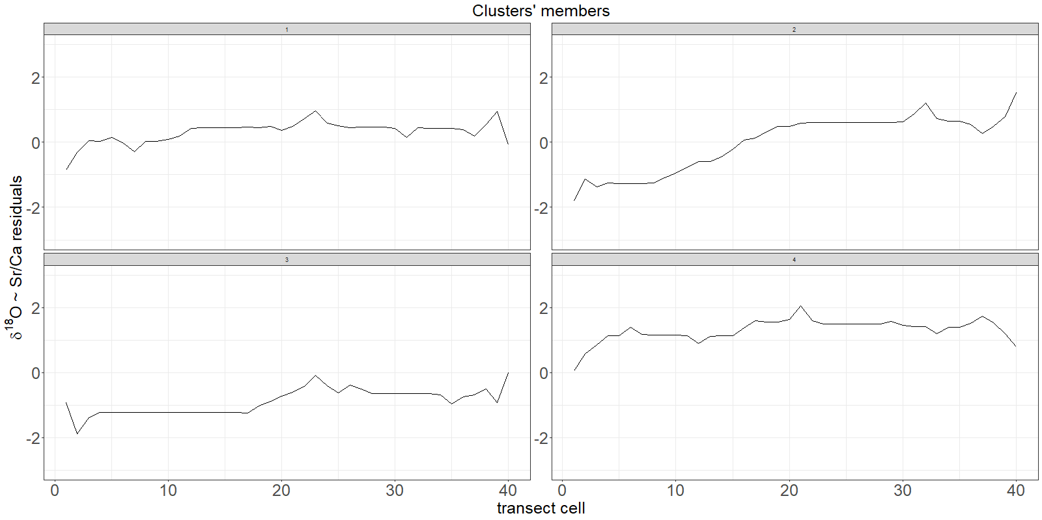
DTW centroids d18O

Slide 10
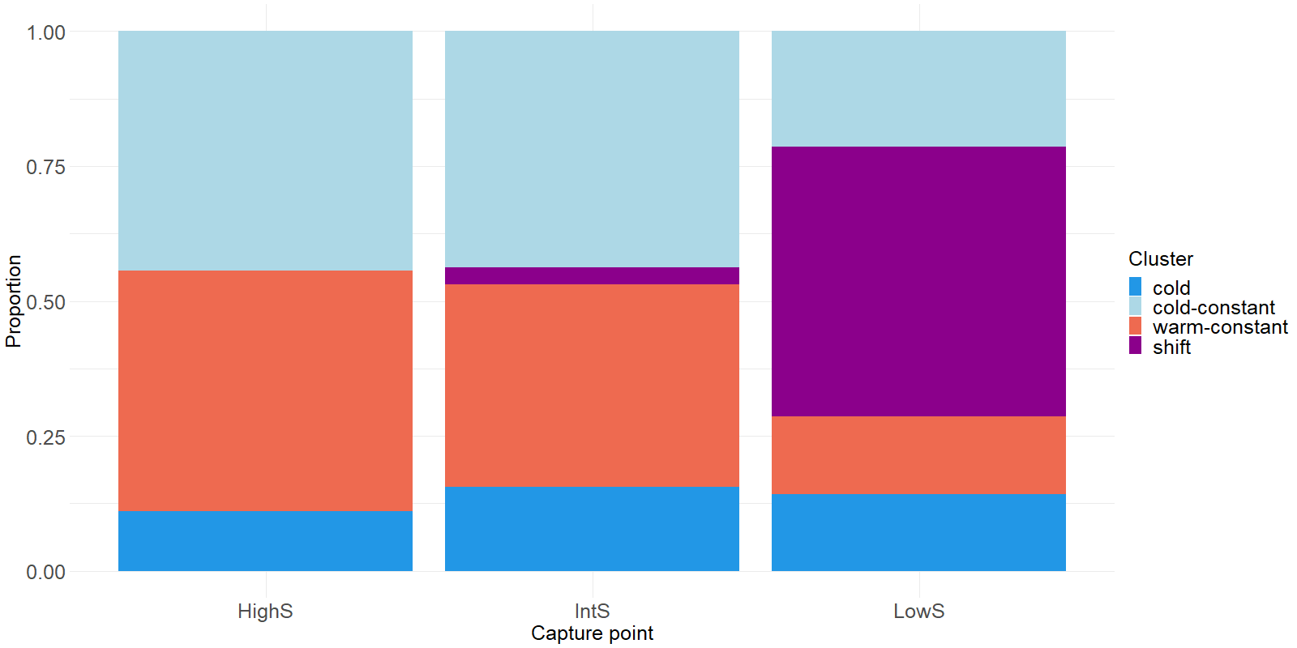
Cluster distribution

Slide 11
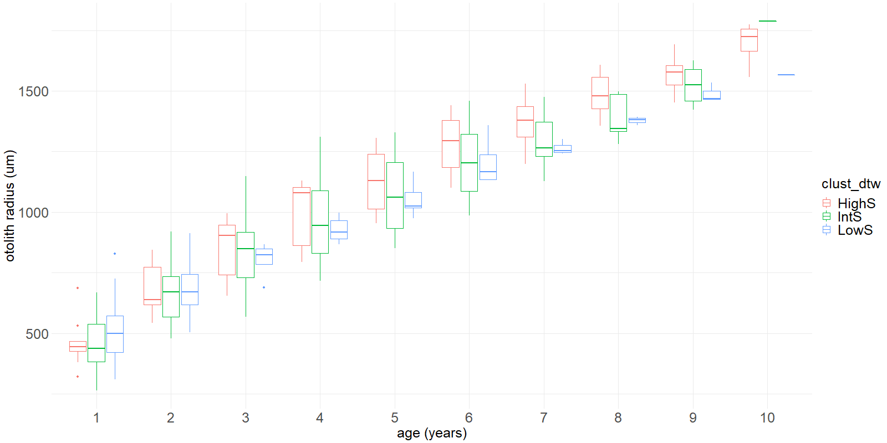
Increment comparison salinity clusters
No sinificant effects, salinity cluster not a sign. Predictor of growth

Slide 12
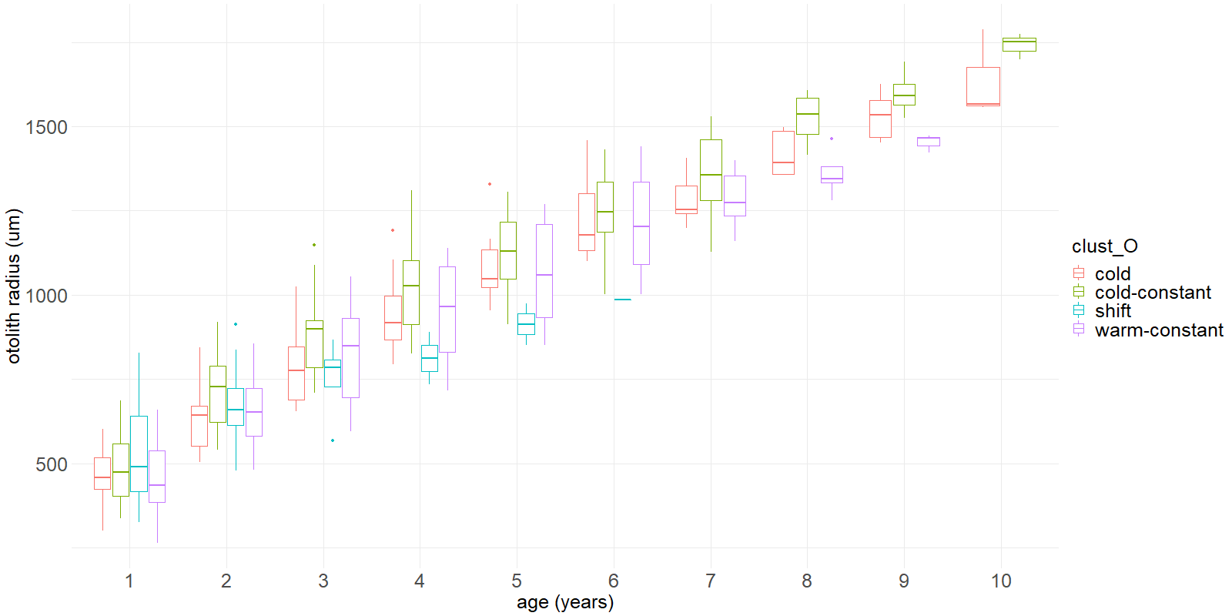
Increment comparison oxygen residual clusters
No sinificant effects, oxygen cluster not a sign. Predictor of growth

